Slide 1
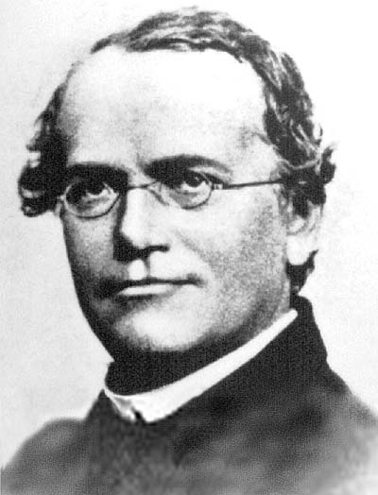
Mendel’s peas
Revision of genetic crossing

Slide 2
What about him?
(NOTE: You are not examined on this bit)
Gregor Mendel studied garden peas in the 1800s
He studied 7 traits (one or two at a time) with contrasting forms
He used large numbers of them and used maths to analyse results
The traits he studied were……

Slide 3






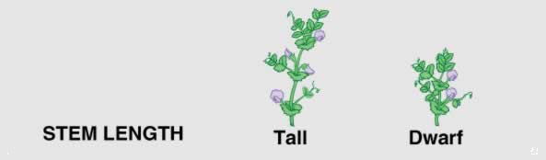

Slide 4
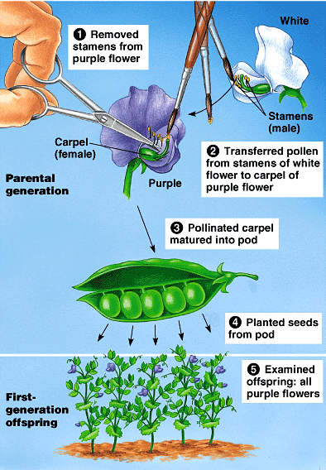
Example
Crossing pure-breeding purple flowered with pure-breeding white flowered plants

Slide 5
Terminology
P1, patrial generation = pure-breeding parents in original cross
F1, first filial generation = offspring of P1 cross
E.g.
  P1: - Pure breeding tall plants X pure breeding short plants
  F1: all the offspring of this cross (all tall)

Slide 6
Mendel’s Findings
Theory of Particulate Inheritance
  Characteristics of both parents are passed on to the next generation as discrete units (we now call genes).
Law of segregation
  Alleles separate during gamete formation. Each gamete gets only one allele.
Law of independent assortment
  The inheritance of one trait does not affect the inheritance of other traits.

Slide 7
Monohybrid Cross
Write the parent phenotypes
Write their genotypes
Write the possible gamete genotypes
Work out the offspring genotypes
Work out the offspring phenotypes (and the phenotype ratio if there is one)

Slide 8
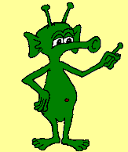
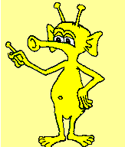
Example
Martians are green if they have at least one G allele.
G is dominant over g.
A Martian with a genotype of gg will be yellow.

Slide 9
Phenotypes P1: Pure-breeding green X pure-breeding yellow
Genotypes: GG x gg
Gamete genotypes G or G and g or g
Offspring genotypes F1: all Gg
Offspring phenotypes: all green

Slide 10
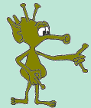

And now the F2
Let’s look at a cross between two heterozygous green Martians
Oh well, it is for science!
Gg x Gg

Slide 11
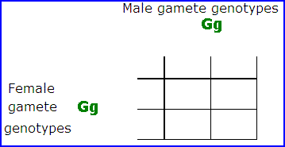
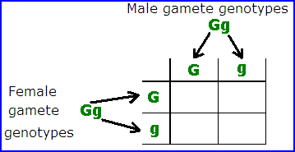
How to do the cross
Write the parents genotypes.
    Gg x Gg
Separate the alleles onto the sides of the square.

Slide 12
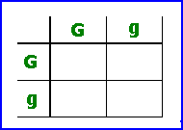
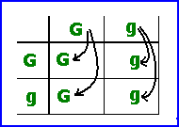
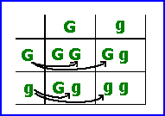
Next
Once you have the alleles separated
Transfer the male alleles down
  Transfer the female alleles across

Slide 13
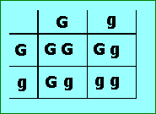
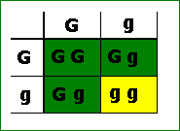
Next
When you have worked out the genotypes
Use them to work out the phenotypes of the offspring
Then work out the phenotype ratio:
  3 green : 1 yellow
  (75% green, 25% yellow)

Slide 14
A back-cross or test cross
This is done to discover the genotype of an individual showing a dominant trait. (They may be hetero- or homozygous).
Cross them with a homozygous recessive individual.
If they are homozygous dominant, all offspring must show the dominant trait.
If some offspring show the recessive trait they must have been heterozygous.

Slide 15
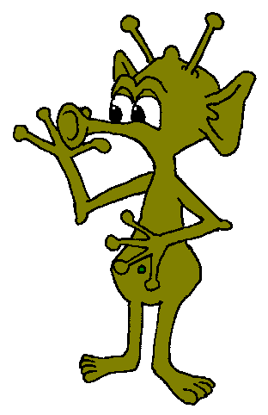
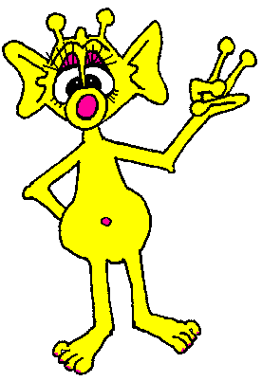
Example back-cross
Is this stud Martian homozygous dominant (GG), or a useless (for breeding purposes), heterozygote (Gg)?
Back-cross him with a yellow female (gg).
If all their offspring are green, chances are he’s homozygous.

Slide 16



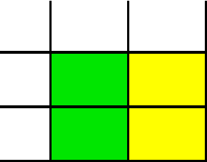
The Punnette squares
If he’s GG
  All offspring must be green
If he is Gg
  Half the offspring will be yellow
G
G
g
G
g
G
g
g
G
g
G
g
G
g
g
G
g
g
g
g
G
g
g
g

Slide 17
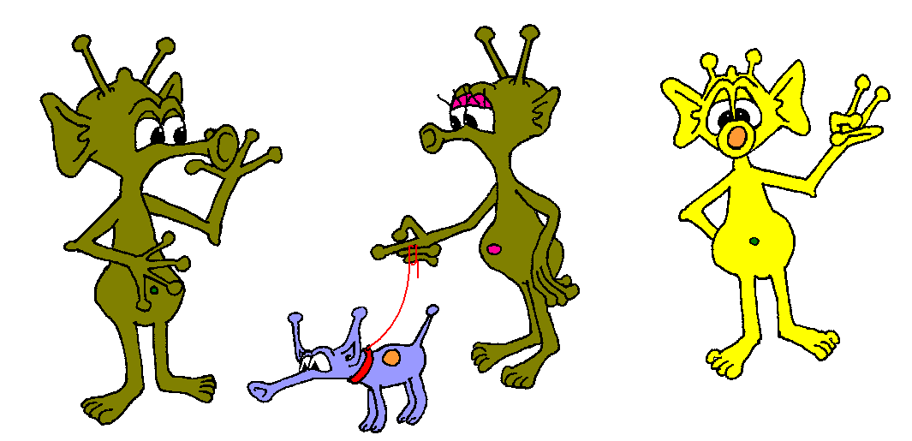
BYE!

